Slide 1
Principles of Anatomy and Physiology
Gerard Tortora and Bryan Derrickson
Sixteenth Edition
Chapter 1
An Introduction to the Human Body
This slide deck contains animations. Please disable animations if they cause issues with your device.
Copyright ©2021 John Wiley & Sons, Inc.

Slide 2
Introduction
The purpose of the chapter is to:
Introduce the disciplines of anatomy and physiology
Discuss the organization of the human body
Reveal shared properties of all living things
Discuss the concept of homeostasis

Slide 3
Anatomy & Physiology Defined

Slide 4
Anatomy vs. Physiology
Anatomy is the study of structure
Physiology is the study of function

Slide 5
Anatomy vs. Physiology
Table 1.1 Selected Branches of Anatomy and Physiology
Branch of Anatomy | Study of
Developmental biology | The growth and development of an individual from fertilization to death.
Embryology (em′-brē-OL-ō-jē; embry- = embryo; -logy = study of) | The first eight weeks of growth and development after fertilization of a human egg; the earliest stage of developmental biology.
Cell biology | Cellular structure and functions.
Histology (his-TOL-ō -jē; hist- = tissue) | Microscopic structure of tissues.
Gross anatomy | Structures that can be examined without a microscope.

Slide 6
Anatomy vs. Physiology
Branch of Anatomy | Study of
Systemic anatomy | Structure of specific systems of the body such as the nervous or respiratory systems.
Regional anatomy | Specific regions of the body such as the head or chest.
Surface (topographical) anatomy | Surface markings of the body to understand internal anatomy through visualization and palpation (gentle touch).
Imaging anatomy | Internal body structures that can be visualized with techniques such as x-rays, MRI, CT scans, and other technologies for clinical analysis and medical intervention.
Clinical anatomy | The application of anatomy to the practice of medicine, dentistry, and other health-related sciences, for example, to aid in the diagnosis and treatment of disease.
Pathological anatomy (path′-ō-LOJ-i-kal; path- = disease) | Structural changes (gross to microscopic) associated with disease.

Slide 7
Anatomy vs. Physiology
Branch of Physiology | Study of
Molecular physiology | Functions of individual molecules such as proteins and DNA.
Neurophysiology (NOOR-ō-fiz-ē-ol'-ō-jē; neuro- = nerve) | Functional properties of nerve cells.
Endocrinology (en'-dō-kri-NOL-ō-jē; endo- = within; -crin = secretion) | Hormones (chemical regulators in the blood) and how they control body functions.
Cardiovascular physiology (kar-dē-ō-VAS-kū-lar; cardi- = heart; vascular = blood vessels) | Functions of the heart and blood vessels.

Slide 8
Anatomy vs. Physiology
Branch of Physiology | Study of
Immunology (im'-ū-NOL-ō-jē; immun- = not susceptible) | The body's defenses against disease-causing agents.
Respiratory physiology (RES-pi-ra-tōr-ē; respira- = to breathe) | Functions of the air passageways and lungs.
Renal physiology (RĒ-nal; ren- = kidney) | Functions of the kidneys.
Exercise physiology | Changes in cell and organ functions due to muscular activity.
Pathophysiology (Path-ō-fiz-ē-ol'-ō-jē) | Functional changes associated with disease and aging.

Slide 9
Levels of Structural Organization and Body Systems

Slide 10
Levels of Structural Organization
Chemical: atoms and molecules
Cellular: cells and their organelles
Tissue: group of similar cells
Organ: contains two or more types of tissues
Organ system: organs that work closely together
Organismal: all organ systems of a complete individual

Slide 11
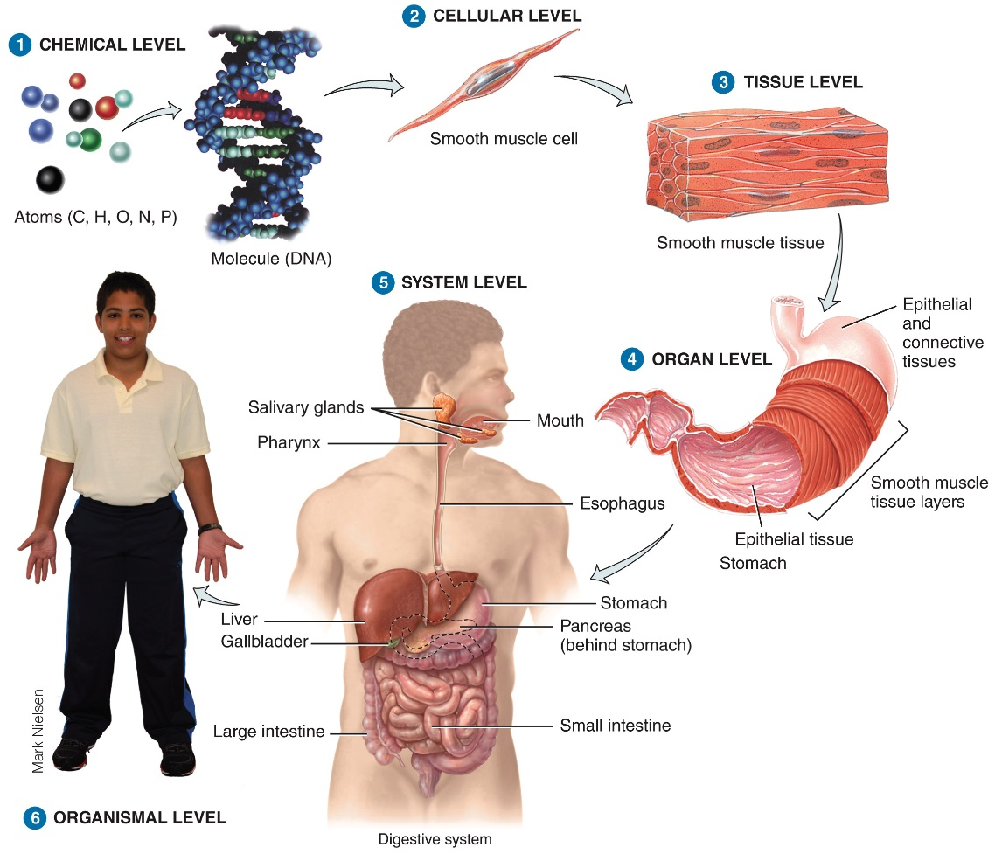
Levels of Structural Organization

Slide 12
Systems of the Human Body
The eleven systems of the human body are the integumentary, skeletal, muscular, nervous, endocrine, cardiovascular, lymphatic/immune, respiratory, digestive, urinary, and reproductive

Slide 13
Systems of the Human Body
Table 1.2 The Eleven Systems of the Human Body
Integumentary System (chapter 5) | Skeletal System (chapters 6-9)
Components: Skin and associated structures, such as hair, fingernails and toenails, sweat glands, and oil glands. | Components: Bones and joints of the body and their associated cartilages.
Functions: Protects body; helps regulate body temperature; eliminates some wastes; helps make vitamin D; detects sensations such as touch, pain, warmth, and cold; stores fat and provides insulation. | Functions: Supports and protects body; provides surface area for muscle attachments; aids body movements; houses cells that produce blood cells; stores minerals and lipids (fats).

Slide 14
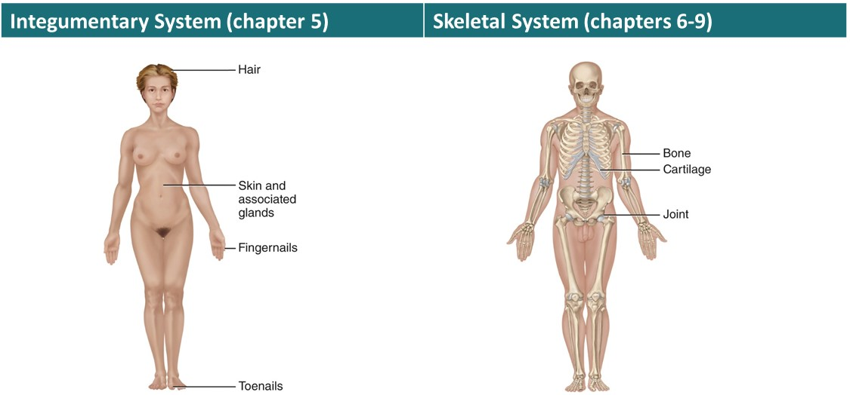
Systems of the Human Body

Slide 15
Systems of the Human Body
Muscular System (Chapters 10, 11) | Nervous System (Chapters 12-17)
Components: Specifically, skeletal muscle tissue—muscle usually attached to bones (other muscle tissues include smooth and cardiac). | Components: Brain, spinal cord, nerves, and special sense organs, such as eyes and ears.
Functions: Participates in body movements, such as walking; maintains posture; produces heat. | Functions: Generates action potentials (nerve impulses) to regulate body activities; detects changes in body's internal and external environments, interprets changes, and responds by causing muscular contractions or glandular secretions.

Slide 16
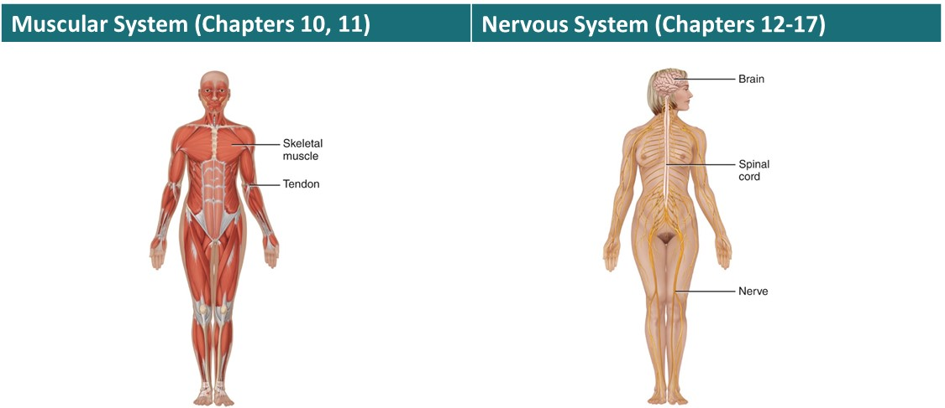
Systems of the Human Body

Slide 17
Systems of the Human Body
Table 1.2 The Eleven Systems of the Human Body
Endocrine System (chapter 18) | Cardiovascular System (chapters 19-21)
Components: Hormone-producing glands (pineal gland, hypothalamus, pituitary gland, thymus, thyroid gland, parathyroid glands, adrenal glands, pancreas, ovaries, and testes) and hormone-producing cells in several other organs. | Components: Blood, heart, and blood vessels.
Functions : Regulates body activities by releasing hormones (chemical messengers transported in blood from endocrine gland or tissue to target organ). | Functions: Heart pumps blood through blood vessels; blood carries oxygen and nutrients to cells and carbon dioxide and wastes away from cells and helps regulate acid–base balance, temperature, and water content of body fluids; blood components help defend against disease and repair damaged blood vessels.

Slide 18
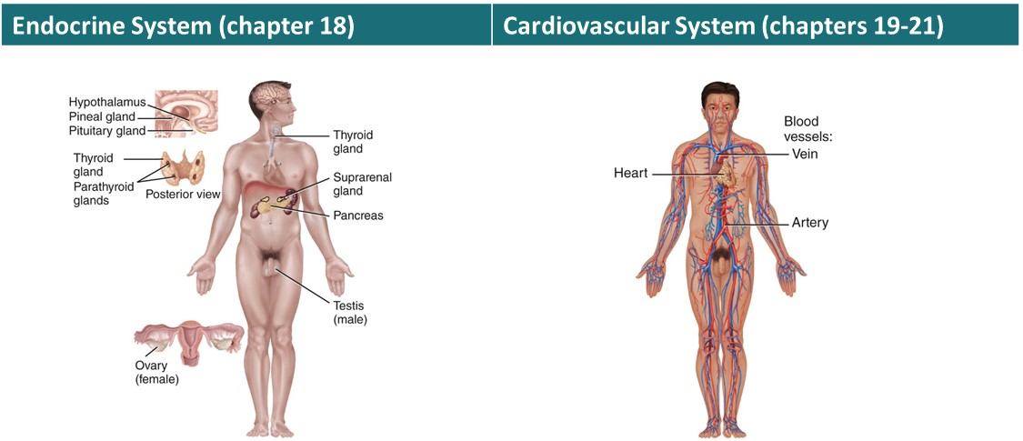
Systems of the Human Body

Slide 19
Systems of the Human Body
Table 1.2 The Eleven Systems of the Human Body
Lymphoid (Lymphatic) System and Immunity (Chapter 22) | Respiratory System (Chapter 23)
Components: Lymphatic fluid (lymph plasma) and lymphatic vessels; spleen, thymus, lymph nodes, and tonsils; cells that carry out immune responses (B cells, T cells, and others). | Components: Lungs and air passageways such as the pharynx (throat), larynx (voice box), trachea (windpipe), and bronchial tubes leading into and out of lungs.
Functions: Returns proteins and fluid to blood; carries lipids from gastrointestinal tract to blood; contains sites of maturation and proliferation of B cells and T cells that protect against disease-causing microbes. | Functions: Transfers oxygen from inhaled air to blood and carbon dioxide from blood to exhaled air; helps regulate acid– base balance of body fluids; air flowing out of lungs through vocal cords produces sounds.

Slide 20
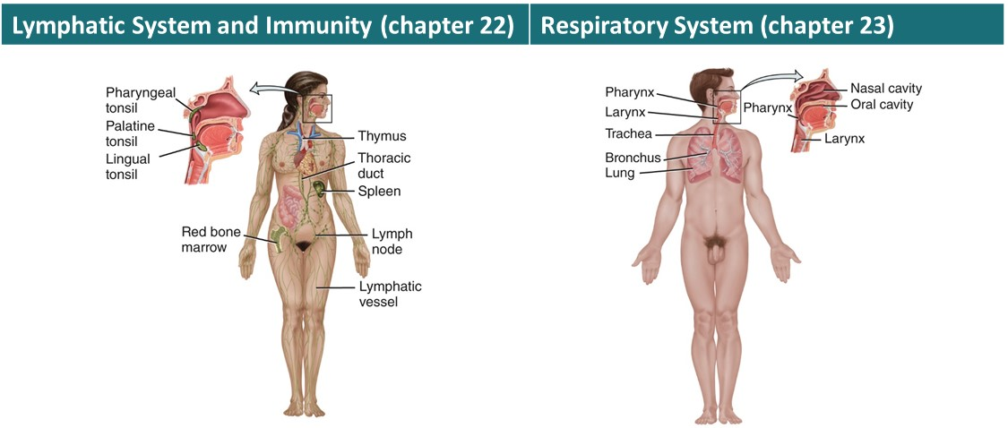
Systems of the Human Body

Slide 21
Systems of the Human Body
Digestive System (chapter 24) | Urinary System (chapter 26)
Components: Organs of gastrointestinal tract, a long tube that includes the mouth, pharynx (throat), esophagus (food tube), stomach, small and large intestines, and anus; also includes accessory organs that assist in digestive processes, such as salivary glands, liver, gallbladder, and pancreas. | Components: Kidneys, ureters, urinary bladder, and urethra.
Functions: Achieves physical and chemical breakdown of food; absorbs nutrients; eliminates solid wastes. | Functions: Produces, stores, and eliminates urine; eliminates wastes and regulates volume and chemical composition of blood; helps maintain the acid–base balance of body fluids; maintains body's mineral balance; helps regulate production of red blood cells.

Slide 22
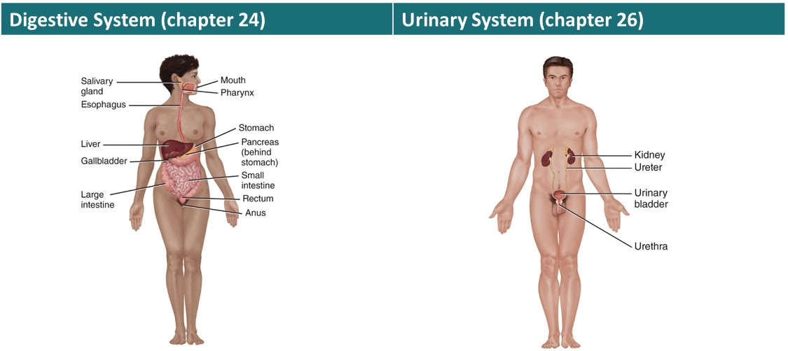
Systems of the Human Body

Slide 23
Systems of the Human Body
Genital (Reproductive) Systems (Chapter 28)
Components: Gonads (testes in males and ovaries in females) and associated organs (uterine tubes, uterus, vagina, clitoris, and mammary glands in females and epididymis, ductus deferens, seminal glands, prostate, and penis in males). Functions: Gonads produce gametes (sperm or oocytes) that unite to form a new organism; gonads also release hormones that regulate reproduction and other body processes; associated organs transport and store gametes; mammary glands produce milk

Slide 24
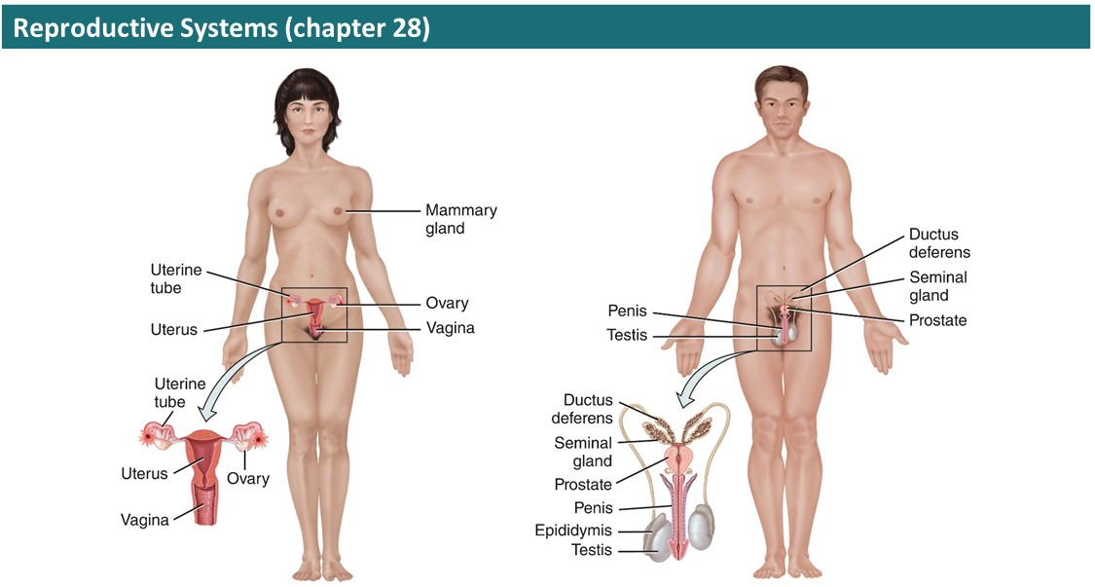
Systems of the Human Body

Slide 25
Characteristics of the Living Human Organism

Slide 26
Basic Life Processes
All living things have certain characteristics that distinguish them from nonliving things
Life processes in humans include metabolism, responsiveness, movement, growth, differentiation, and reproduction

Slide 27
Homeostasis
Homeostasis is a condition of equilibrium, or balance, in the body’s internal environment
Homeostasis is maintained by the body’s regulatory processes
Involves continuous monitoring and regulation of many factors
Nervous and endocrine systems accomplish this communication via nervous impulses and hormones
Nervous system – fast acting; often short-lived effects
Endocrine – slow acting; often longer-lived effects

Slide 28
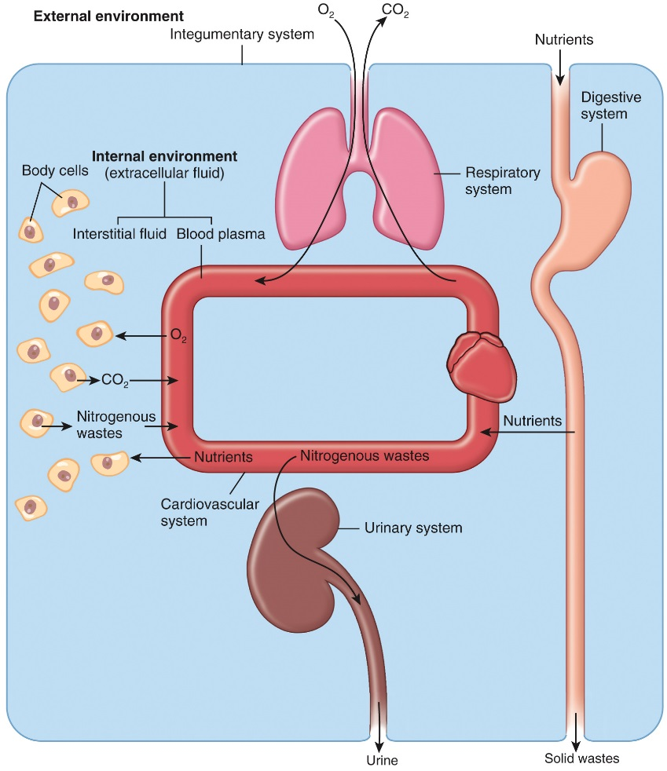
Body Fluids & Homeostasis
The survival of our body cells is dependent on the precise regulation of the chemical composition of their surrounding fluid
This fluid is known as extracellular fluid

Slide 29
Control of Homeostasis

Slide 30
Homeostasis
Homeostatic imbalances occur because of disruptions from the external or internal environments
Interactions Animation
Communication, Regulation, and Homeostasis
Negative Feedback Control of Temperature Regulation
Notes:
You must be connected to the Internet and in Slideshow Mode to run this animation.

Slide 31
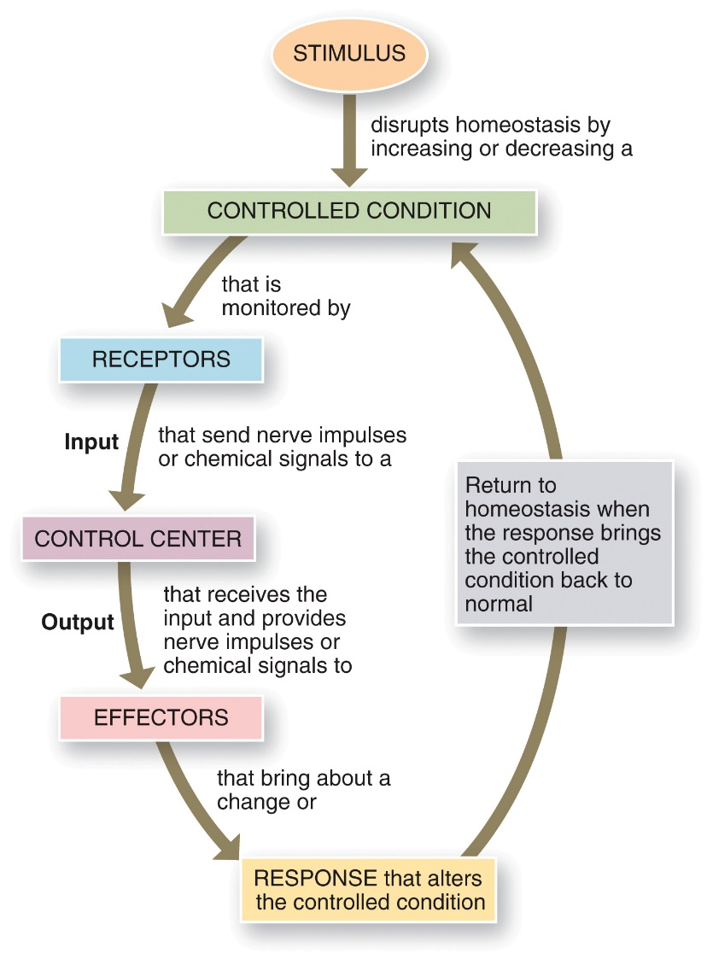
Control of Homeostasis
The basic components of a feedback loop

Slide 32
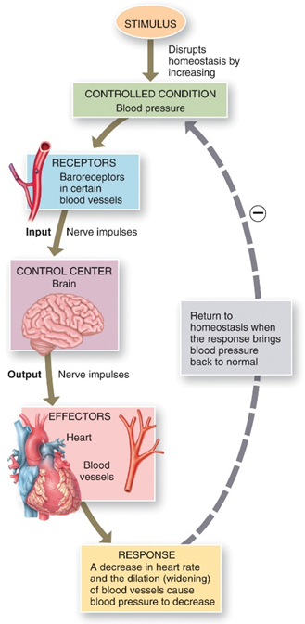
Control of Homeostasis: Negative Feedback
The response reduces or shuts off the original stimulus
Examples:
Regulation of body temperature (a nervous mechanism)
Regulation of blood volume by ADH (an endocrine mechanism)

Slide 33
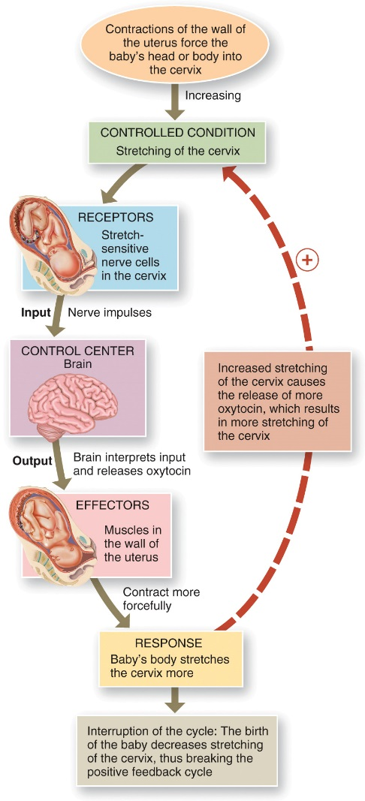
Control of Homeostasis: Positive Feedback
Response enhances or exaggerates the original stimulus
May exhibit a cascade or amplifying effect
Usually controls infrequent events
Enhancement of labor contractions by oxytocin
Platelet plug formation and blood clotting
Notes:
You must be connected to the Internet and in Slideshow Mode to run this animation.

Slide 34
Control of Homeostasis: Positive Feedback
Interactions Animation:
Positive Feedback Control of Labor
Notes:
You must be connected to the Internet and in Slideshow Mode to run this animation.

Slide 35
Homeostatic Imbalances
When homeostasis is disrupted it may result in disease, disorder, or even death
Factors such as your genetic make-up, the air you breathe, and the food you eat can all affect your health

Slide 36
Basic Anatomical Terminology

Slide 37
Types of Anatomical Terminology
Body positions
Regional names
Directional terms
Planes and sections
Body cavities

Slide 38
Body Positions: The Anatomical Position
Anatomical position is a standardized method of observing or imaging the body that allows precise and consistent anatomical reference
Person stands erect, facing the observer, the upper extremities are places at the sides, the palms of the hands are turned forward, and the feet are flat on the floor

Slide 39
Body Positions
Two major divisions of body:
Axial
Head, neck, trunk
Appendicular
Limbs, shoulder girdle, pelvic girdle
Anatomical terms to describe the reclining body are prone and supine
Prone = body lying facedown
Supine = body lying faceup

Slide 40
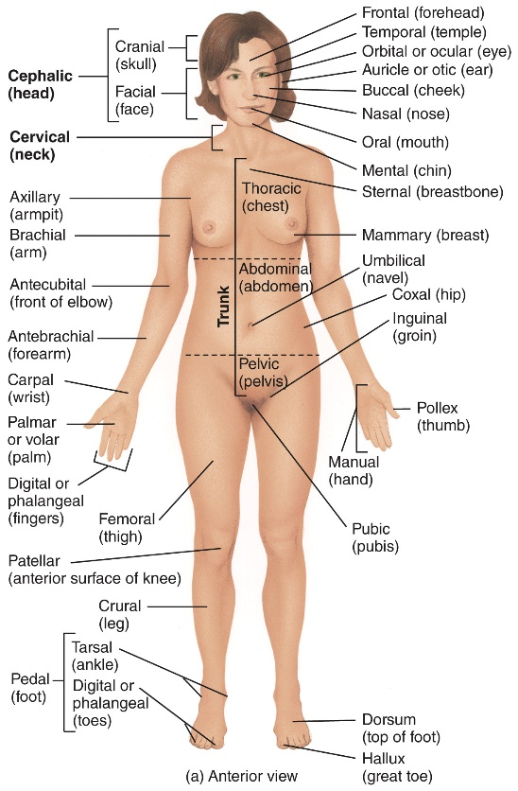
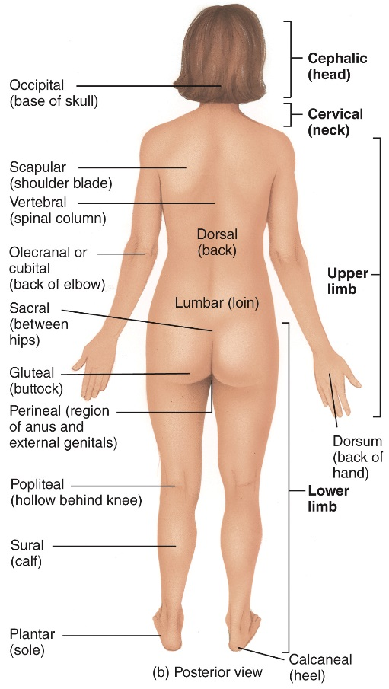
Regional Names
Names given to specific regions of the body for reference

Slide 41
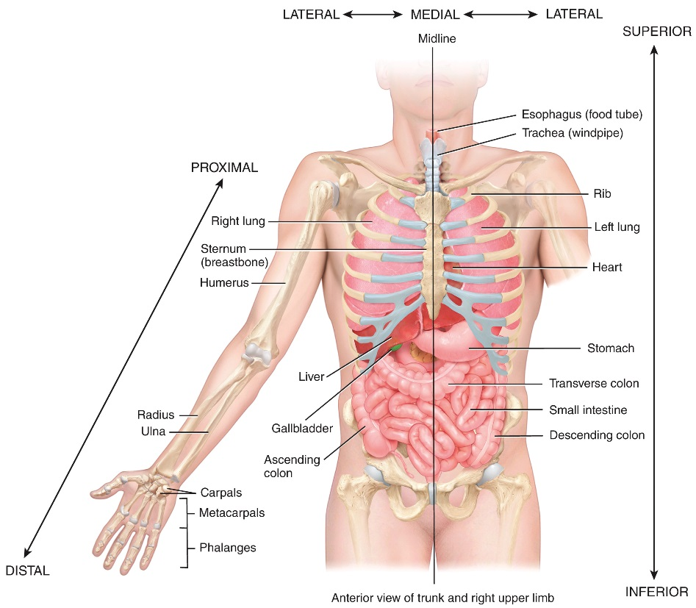
Directional Terms
Used to precisely locate one part of the body relative to another

Slide 42
Directional Terms
Directional term | Definition | Example of Use
Superior (soo'-PĒR-ē-or) (cephalic or cranial) | Toward the head, or the upper part of a structure. | The heart is superior to the liver.
Inferior (in-FĒ-rē-or) (caudal) | Away from the head, or the lower part of a structure. | The stomach is inferior to the lungs.
Anterior (an-TĒR-ē-or) (ventral)* | Nearer to or at the front of the body. | The sternum (breastbone) is anterior to the heart.
Posterior (pos-TĒR-ē-or) (dorsal) | Nearer to or at the back of the body. | The esophagus (food tube) is posterior to the trachea (windpipe).
Medial (MĒ-dē-al) | Nearer to the midline (an imaginary vertical line that divides the body into equal right and left sides). | The ulna is medial to the radius.

Slide 43
Directional Terms
Directional term | Definition | Example of Use
Lateral (LAT-er-al) | Farther from the midline. | The lungs are lateral to the heart.
Intermediate (in'-ter-MĒ-dē-at) | Between two structures. | The transverse colon is intermediate to the ascending and descending colons.
Ipsilateral (ip-si-LAT-er-al) | On the same side of the body as another structure. | The gallbladder and ascending colon are ipsilateral.
Contralateral (KON-tra-lat-er-al) | On the opposite side of the body from another structure. | The ascending and descending colons are contralateral.
Proximal (PROK-si-mal) | Nearer to the attachment of a limb to the trunk; nearer to the origination of a structure. | The humerus (arm bone) is proximal to the radius.

Slide 44
Directional Terms
Directional term | Definition | Example of Use
Distal (DlS-tal) | Farther from the attachment of a limb to the trunk; farther from the origination of a structure. | The phalanges (finger bones) are distal to the carpals (wrist bones).
Superficial (soo'-per-FISH-al) (external) | Toward or on the surface of the body. | The ribs are superficial to the lungs.
Deep (Internal) | Away from the surface of the body. | The ribs are deep to the skin of the chest and back.
*Note that the terms anterior and ventral mean the same thing in humans. However, in four-legged animals ventral refers to the belly side and is therefore inferior. Similarly, the terms posterior and dorsal mean the same thing in humans, but in four-legged animals dorsal refers to the back side and is therefore superior.

Slide 45
Planes and Sections
Flat surface along which body structure is cut for anatomical study
Sagittal
Divides body vertically into left and right sides
Midsagittal/median
Lies on midline; equal left and right sides
Parasagittal/paramedian
Not on midline; unequal left and right sides

Slide 46
Planes and Sections
Frontal/coronal
Divides body vertically into anterior and posterior sections
Transverse/horizontal
Divides body horizontally into superior and inferior sections
Produces a cross section
Oblique
Cuts made diagonally

Slide 47
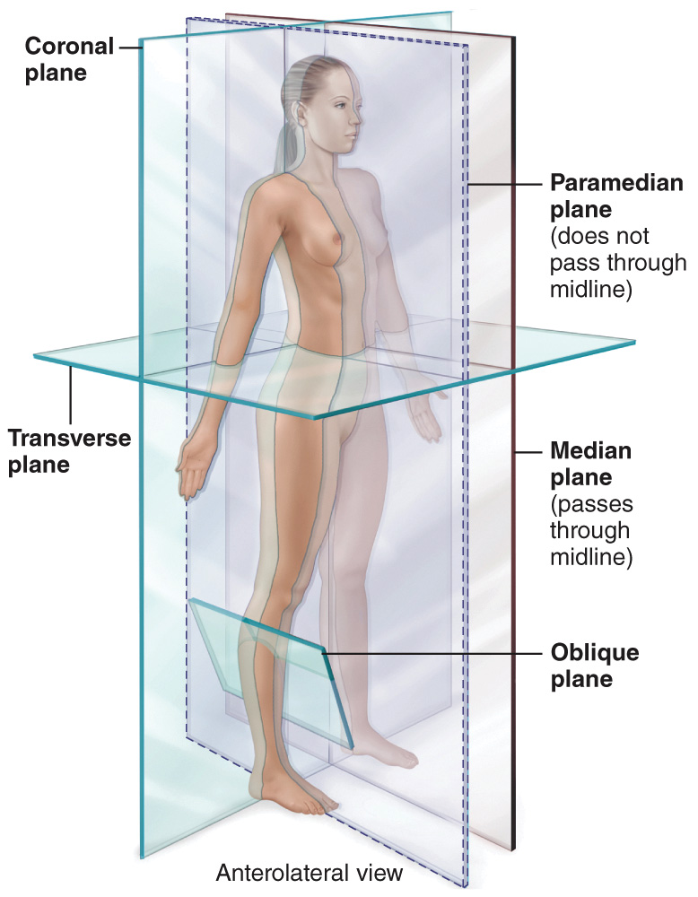
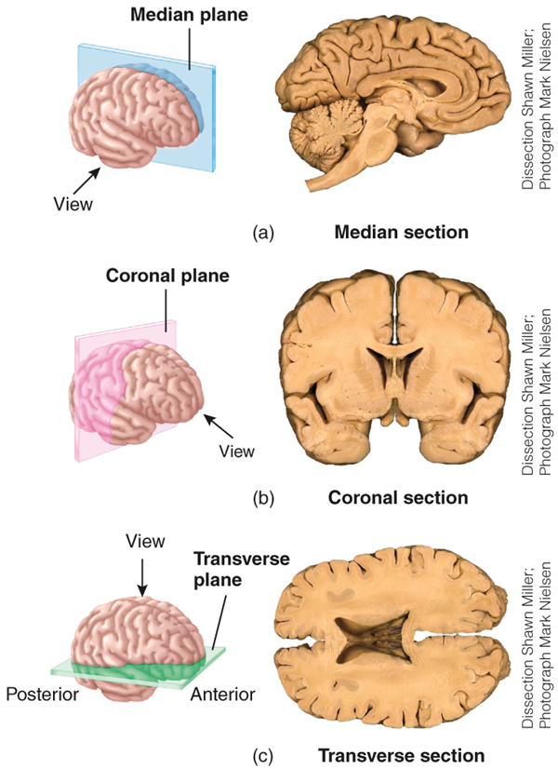
Planes and Sections

Slide 48
Body Cavities
Dorsal cavity
Protects nervous system
Two subdivisions:
Cranial cavity
Encases brain
Vertebral cavity
Encases spinal cord
Ventral cavity
Houses internal organs (viscera)
Two subdivisions (separated by diaphragm)
Thoracic cavity
Abdominopelvic cavity

Slide 49
Ventral Cavities
Thoracic cavity subdivisions:
Two pleural cavities
Each houses a lung
Mediastinum
Pericardial cavity
Encloses heart
Surrounds thoracic organs
Trachea, thyroid gland
Abdominopelvic cavity subdivisions:
Abdominal cavity
Contains stomach, intestines, spleen, pancreas, liver
Most vulnerable to damage since it’s not surrounded by bone
Pelvic cavity
Contains urinary bladder, reproductive organs, rectum

Slide 50
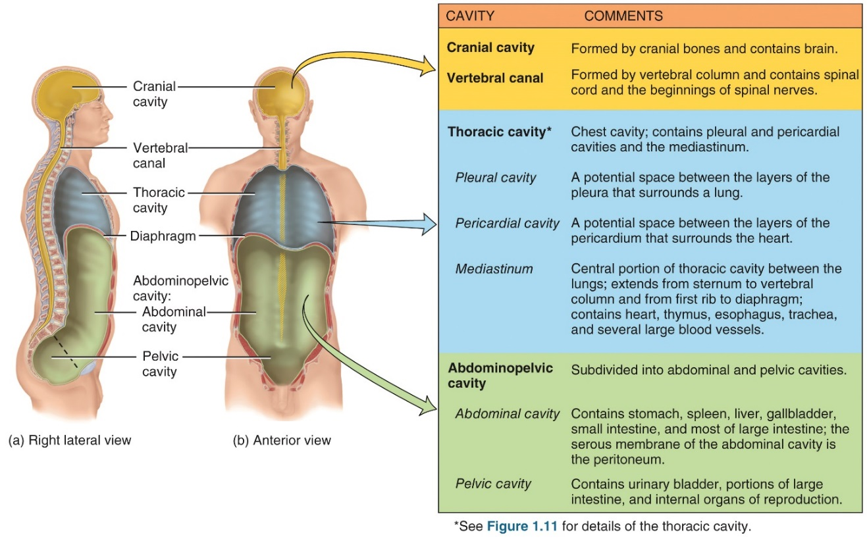
Body Cavities

Slide 51
Serous Membranes
Serous membranes are thin, double-layered membranes that cover the viscera within the thoracic and abdominal cavities and also line the walls of the thorax and abdomen
Visceral layer covers the internal organs
Parietal layer lines internal body walls
Serous membranes reduce friction

Slide 52
Serous Membranes in the Abdominal Cavity
Thoracic cavity
Pericardium
Covers heart
Pleura
Covers lungs
Abdominal cavity
Peritoneum
Covers many abdominal organs
Retroperitoneal
Classification given to some organs because they are not surrounded by peritoneum, rather, they are posterior to it

Slide 53
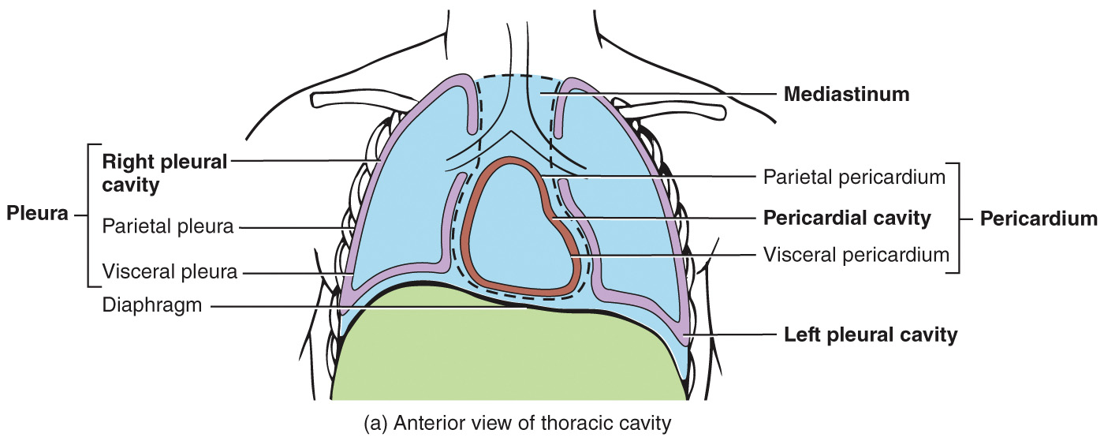
Serous Membranes in the Thoracic Cavity
The pericardium and pleura cover the heart and lungs, respectively

Slide 54
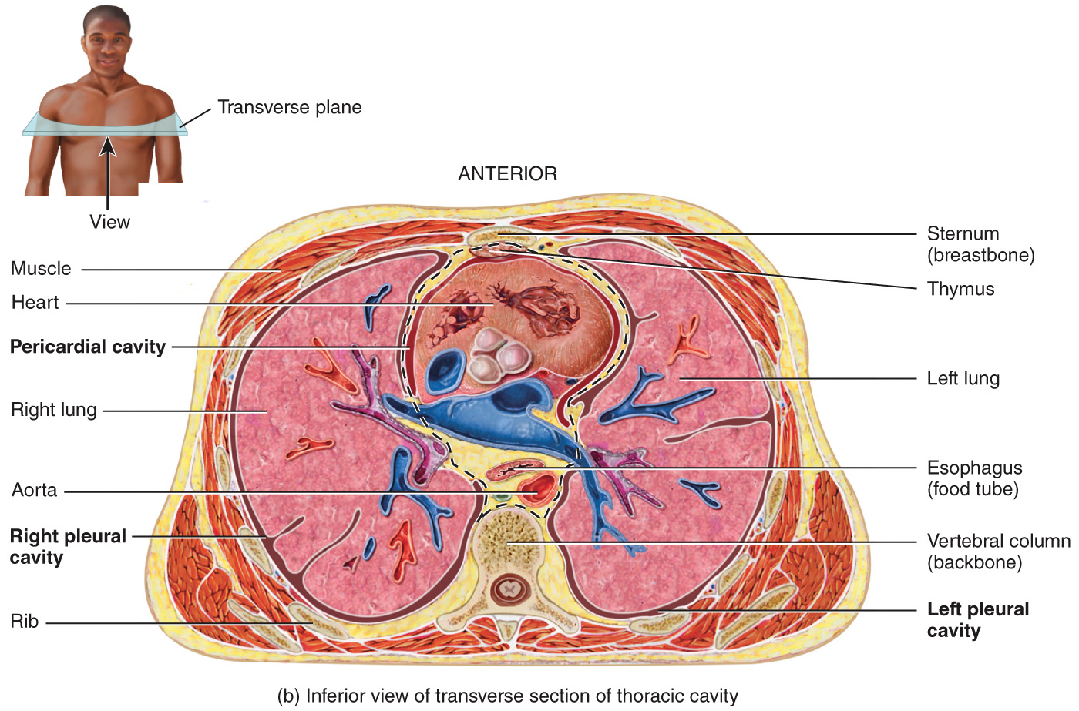
Serous Membranes in the Thoracic Cavity

Slide 55
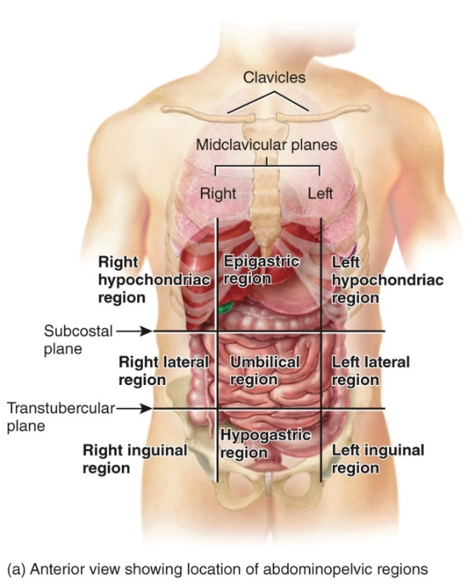
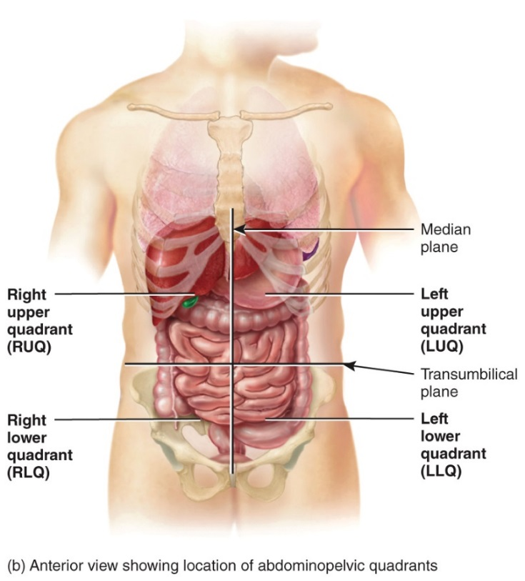
Abdominopelvic Regions & Quadrants
The abdominal cavity can be divided into regions or quadrants to easily describe the location of organs
“lateral” is often referred to as “lumbar”; “inguinal” is often referred to as “iliac”

Slide 56
Aging and Homeostasis
Aging is a normal process characterized by a progressive decline in the body’s ability to restore homeostasis
Impacts all body systems
Produces structural and functional changes
Increases vulnerability to stress and disease

Slide 57
Medical Imaging
Medical imaging involves techniques that allow physicians to view images of the human body
This allows physicians to diagnose anatomical and physiological abnormalities

Slide 58
Medical Imaging Procedures: Radiography is only one of a number of imaging procedures
Table 1.3 Common Medical Imaging Procedures
Radiography
Procedure: A single barrage of x-rays passes through the body, producing an image of interior structures on x-ray-sensitive film. The resulting two- dimensional image is a radiograph (RA-dē-ō-graf’), commonly called an x-ray. Comments: Relatively inexpensive, quick, and simple to perform; usually provides sufficient information for diagnosis. X-rays do not easily pass through dense structures, so bones appear white. Hollow structures, such as the lungs, appear black. Structures of intermediate density, such as skin, fat, and muscle, appear as varying shades of gray. At low doses, x-rays are useful for examining soft tissues such as the breast (mammography) and for determining bone density (bone densitometry or DEXA scan). It is necessary to use a substance called a contrast medium to make hollow or fluid-filled structures visible (appear white) in radiographs. X-rays make structures that contain contrast media appear white. The medium may be introduced by injection, orally, or rectally, depending on the structure to be imaged. Contrast x-rays are used to image blood vessels (angiography), the urinary system (intravenous urography), and the gastrointestinal tract (barium contrast x-ray).

Slide 59
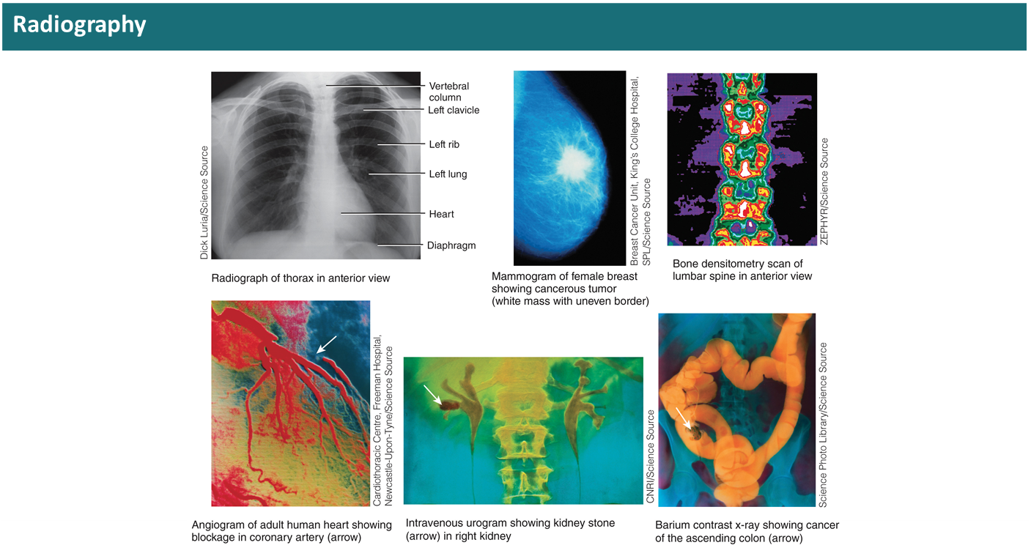
Medical Imaging Procedures: Radiography

Slide 60
Medical Imaging Procedures: MRI and CT
Magnetic Resonance Imaging (MRI) | Computed Tomography (CT)
Procedure: The body is exposed to a high-energy magnetic field, which causes protons (small positive particles within atoms, such as hydrogen) in body fluids and tissues to arrange themselves in relation to the field. Then a pulse of radio waves "reads" these ion patterns, and a color-coded image is assembled on a video monitor. The result is a two- or three- dimensional blueprint of cellular chemistry. | [formerly called computerized axial tomography (C A T) scanning) Procedure: In this form of computer-assisted radiography, an x-ray beam traces an arc at multiple angles around a section of the body. The resulting transverse section of the body, called a CT scan, is shown on a video monitor.

Slide 61
Medical Imaging Procedures: MRI and CT
Magnetic Resonance Imaging (MRI) | Computed Tomography (CT)
Comments: Relatively safe but cannot be used on patients with metal in their bodies. Shows fine details for soft tissues but not for bones. Most useful for differentiating between normal and abnormal tissues. Used to detect tumors and artery-clogging fatty plaques; reveal brain abnormalities; measure blood flow; and detect a variety of musculoskeletal, liver, and kidney disorders. | Comments: Visualizes soft tissues and organs with much more detail than conventional radiographs. Differing tissue densities show up as various shades of gray. Multiple scans can be assembled to build three"−"dimensional views of structures (described next). Whole-body CT scanning typically targets the torso and appears to provide the most benefit in screening for lung cancers, coronary artery disease, and kidney cancers.

Slide 62
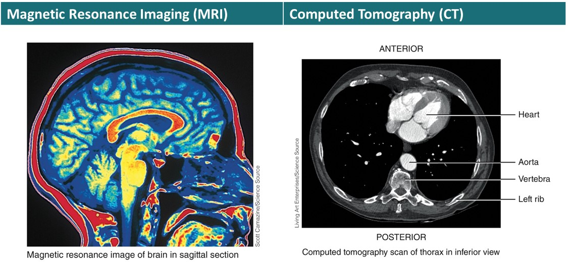
Medical Imaging Procedures: MRI and CT

Slide 63
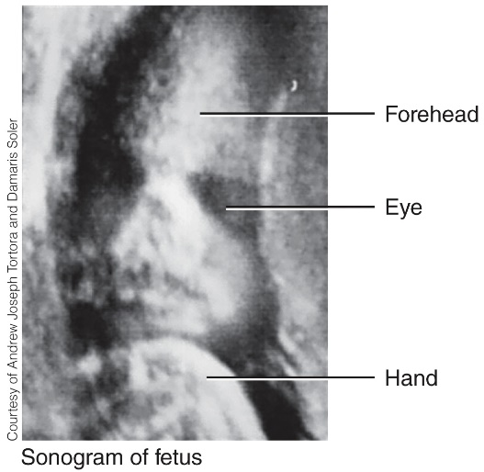
Medical Imaging Procedures: Ultrasound Scanning
Ultrasound Scanning
Procedure: High‐frequency sound waves produced by a handheld wand reflect off body tissues and are detected by the same instrument. The image, which may be still or moving, is called a sonogram (SON-ō-gram) and is shown on a video monitor. Comments: Safe, noninvasive, painless, and uses no dyes. Most commonly used to visualize the fetus during pregnancy. Also used to observe the size, location, and actions of organs and blood flow through blood vessels (Doppler ultrasound).

Slide 64
Medical Imaging Procedures: C C T A and P E T scan
Coronary (CARDIAC) Computed Tomography Angiography (C C T A) SCAN | Positron Emission Tomography (P E T)
Procedure: In this form of computer-assisted radiography, an iodine-containing contrast medium is injected into a vein and a beta blocker is given to decrease heart rate. Then, numerous x-ray beams trace an arc around the heart and a scanner detects the x-ray beams and transmits them to a computer, which transforms the information into a three-dimensional image of the coronary blood vessels on a monitor. The image produced is called a CCT A scan and can be generated in less than 20 seconds. | Procedure: A substance that emits positrons (positively charged particles) is injected into the body, where it is taken up by tissues. The collision of positrons with negatively charged electrons in body tissues produces gamma rays (similar to x-rays) that are detected by gamma cameras positioned around the subject. A computer receives signals from the gamma cameras and constructs a P E T scan image, displayed in color on a video monitor. The P E T scan shows where the injected substance is being used in the body. In the P E T scan image shown here, the black and blue colors indicate minimal activity; the red, orange, yellow, and white colors indicate areas of increasingly greater activity.

Slide 65
Medical Imaging Procedures: C C T A and P E T scan
Coronary (CARDIAC) Computed Tomography Angiography (C C T A) SCAN | Positron Emission Tomography (P E T)
Comments: Used primarily to determine if there are any coronary artery blockages (for example, atherosclerotic plaque or calcium) that may require an intervention such as angioplasty or stent. The C C T A scan can be rotated, enlarged, and moved at any angle. The procedure can take thousands of images of the heart within the time of a single heartbeat, so it provides a great amount of detail about the heart's structure and function. | Comments: Used to study the physiology of body structures, such as metabolism in the brain or heart.

Slide 66
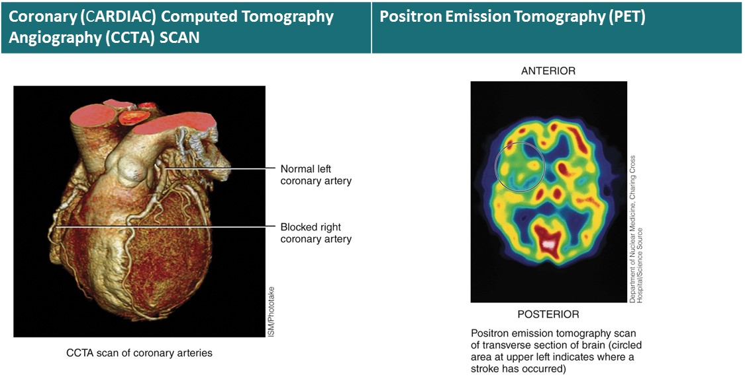
Medical Imaging Procedures: C C T A and P E T scan

Slide 67
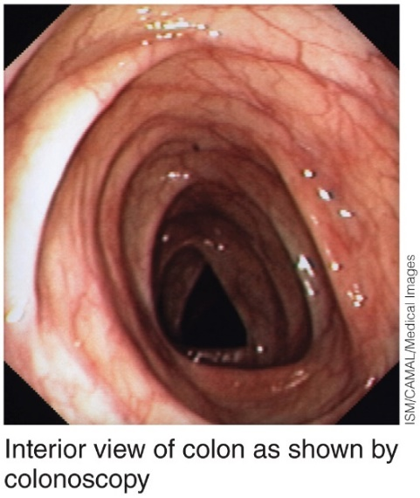
Medical Imaging Procedures: Endoscopy
Endoscopy
Procedure: Endoscopy involves the visual examination of the inside of body organs or cavities using a lighted instrument with lenses called an endoscope. The image is viewed through an eyepiece on the endoscope or projected onto a monitor. Comments: Examples include colonoscopy (used to examine the interior of the colon, which is part of the large intestine), laparoscopy (used to examine the organs within the abdominopelvic cavity), and arthroscopy (used to examine the interior of a joint, usually the knee).

Slide 68
Medical Imaging Procedures: Radionuclide Scanning
Radionuclide Scanning
Procedure: A radionuclide (radioactive substance) is introduced intravenously into the body and carried by the blood to the tissue to be imaged. Gamma rays emitted by the radionuclide are detected by a gamma camera outside the subject, and the data are fed into a computer. The computer constructs a radionuclide image and displays it in color on a video monitor. Areas of intense color take up a lot of the radionuclide and represent high tissue activity; areas of less intense color take up smaller amounts of the radionuclide and represent low tissue activity. Single-photon-emission computed tomography (SPECT) scanning is a specialized type of radionuclide scanning that is especially useful for studying the brain, heart, lungs, and liver. Comments: Used to study activity of a tissue or organ, such as searching for malignant tumors in body tissue or scars that may interfere with heart muscle activity.

Slide 69
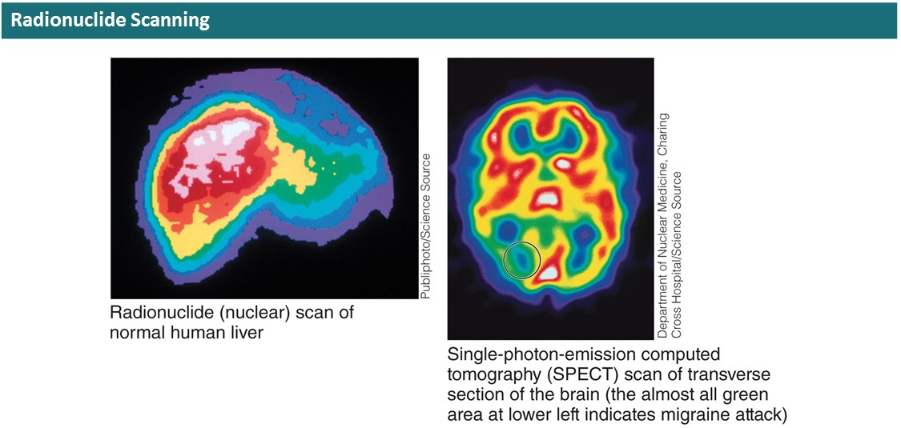
Medical Imaging Procedures: Radionuclide Scanning

Slide 70
Copyright
Copyright © 2021 John Wiley & Sons, Inc.
All rights reserved. Reproduction or translation of this work beyond that permitted in Section 117 of the 1976 United States Copyright Act without the express written permission of the copyright owner is unlawful. Request for further information should be addressed to the Permissions Department, John Wiley & Sons, Inc. The purchaser may make back-up copies for his/her own use only and not for distribution or resale. The Publisher assumes no responsibility for errors, omissions, or damages caused by the use of these programs or from the use of the information contained herein.

